Slide 1
Computing Global Dimensions of Endomorphism Rings over modules of finite cohen-macaulay type
Brandon Doherty
Supervisor: Dr. Colin Ingalls

Slide 2
Assumptions
R indicates a complete local commutative Noetherian ring.
R has finitely many indecomposable Cohen-Macaulay modules up to isomorphism (finite CM type).

Slide 3
A couple of definitions
Module: like a vector space, but over any ring (not necessarily a field)
Exact sequence:
α
β
A → B → C
Im(α) = ker(β)

Slide 4
Splicing exact sequences
α, δ injective
β, ε surjective

Slide 5
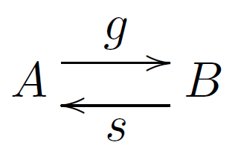
Projective modules
g ○ s = id_{B}, then s is a section of g
g is surjective, say g is a split epimorphism
A module P is projective if :
∀ X → P, h surjective → h split
h

Slide 6
Projective resolutions
… → P₁ →P₀ → M → 0
P_{i} projective
Global dimension of a ring R: maximum length of minimal projective resolutions of modules over R

Slide 7
Hom functor

Slide 8
Indecomposables
Say we have a module
M_{i} are finitely generated indecomposable CM modules over a ring R
add(M) is the category of finite direct sums of the M_{i}.
Notes:
Where I’ve written (sum), I’ll change that to an actual direct sum symbol if I present at the conference.

Slide 9
Projectives and simples
is equal to the supremum of lengths of minimal projective resolutions of simple modules over End_{R}(M).
Indecomposable projectives have the form
.
Simple modules are quotients of .

Slide 10
add(M)-almost-split-sequences
Apply Hom functor:
This is the beginning of a projective resolution of S_{i}

Slide 11
add(M) approximations
Apply Hom functor:
We can splice this in to continue making the projective resolution of S_{i} :

Slide 12
Resolutions of simples
Eventually we get a projective resolution of S_{i} :
This may be infinite.
We may write it as a pre-resolution:

Slide 13
Recap
Given a pre-resolution
we can apply the Hom functor to obtain a projective resolution:
So the maximum length of pre-resolutions of indecomposable summands of M is equal to the Gl. Dim. of End_{R}(M).
2
1
0
2
1
0

Slide 14
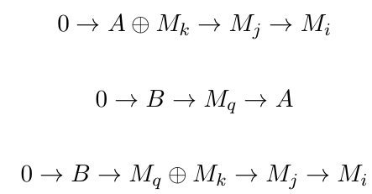
Mixed kernels

Slide 15
Auslander-Reiten Quiver
For a ring R, a directed graph:
Vertices: indecomposable CM modules over R
Arrows: irreducible homomorphisms between modules
AR translate τ: an automorphism on non-projective modules.
.
For a finite CM type ring, there are finitely many vertices.

Slide 16
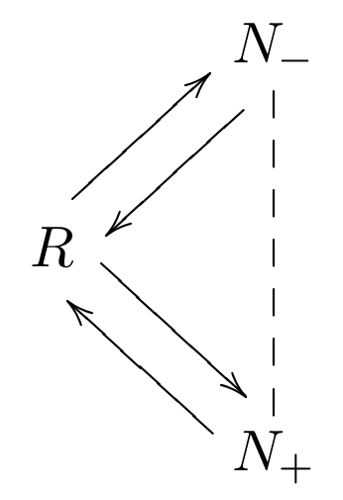
AR sequence
For a module M:

Slide 17
Simple curve singularities
For this project, we’ve been computing global dimensions of finitely generated maximal Cohen-Macaulay modules over finite CM type curve and surface singularities.

Slide 18
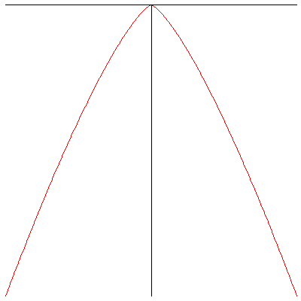
Simple curve singularities
R = k[[x,y]]/f
k algebraically closed field of characteristic zero
f polynomial describing simple curve singularity
Simple curve singularities are finite type.

Slide 19
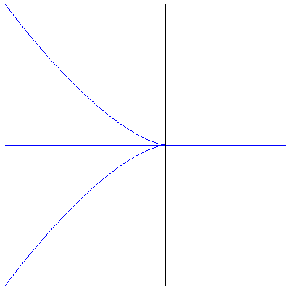
Simple curve singularities
E₆ : x⁴ + y³ = 0
E₇ : x³y + y³ = 0
E₈ : x⁵ + y³ = 0
A_{n} : x^{n+1} + y² = 0 , n ≥ 1
D_{n} : x²y + y^{n-1} = 0 , n ≥ 4

Slide 20
E₆ : x⁴ + y³ = 0

Slide 21
E₇ : x³y + y³ = 0

Slide 22
E₈ : x⁵ + y³ = 0

Slide 23
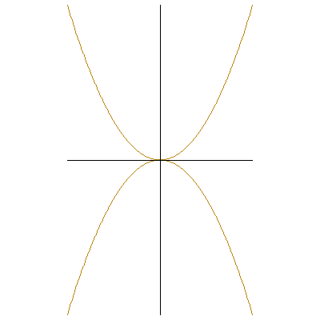
A_{n} : x^{n+1} + y² = 0
A₂
A₃

Slide 24
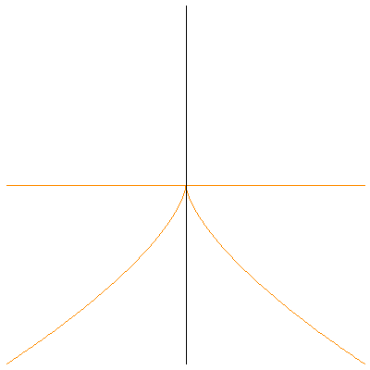
D_{n} : x²y + y^{n-1} = 0
D₄
D₅

Slide 25
A_{n}, n even

Slide 26
A_{n}, n odd

Slide 27
E₆

Slide 28
The Iyama-Wemyss algorithm
We have an algorithm developed by Iyama and Wemyss (2010) to compute add(M)-almost-split-sequences and add(M)-approximations, which splice to give pre-resolutions.
Example: compute the global dimension of
, where over A_{5.}

Slide 29
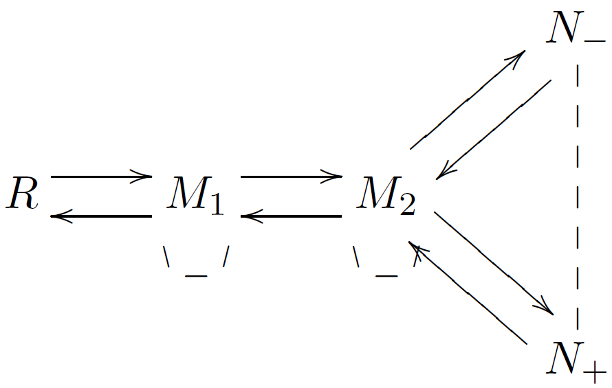
A₅

Slide 30
Universal Cover
Universal Cover of an AR quiver:
Infinite directed graph which gives back original AR quiver when vertices identified
Preserves tau
Covers every other cover that preserves tau

Slide 33
v

Slide 36
Circled vertices count as zero

Slide 37
Negative-numbered vertices count as zero

Slide 39
Constructing the sequence
Negative vertices – 1st term
Circled vertices – 2nd term
Multiplicities determined by vertex numbers

Slide 41
Splicing sequences
Pre-resolution of N-
Length 3
Length 2
Gldim(A) = 3

Slide 42
Other possibility
The kernel of some sequence is repeated
Pre-resolution (and global dimension) must be infinite

Slide 43
McKay Graphs
For a finite matrix group and representation :
Vertices: Irreducible representations of
n arrows from to when is an n-dimensional vector space over k.

Slide 44
Finite matrix groups
: a finite matrix group containing no pseudoreflections
Acting on a polynomial ring where has characteristic zero
Then the McKay graph of is the AR quiver of its invariant ring , also a finite CM type surface singularity.
AR translate:
τ is defined for all modules.

Slide 45
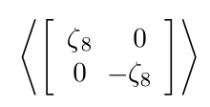
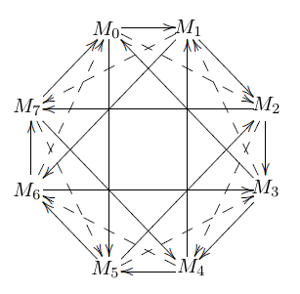
Example:

Slide 46
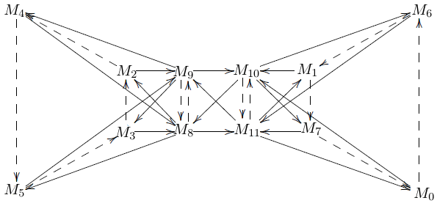
Example:

Slide 47
More examples

Slide 48
Results
Code: http://kappa.math.unb.ca/studentProjects/brandoncode.html
Paper: B. Doherty, E. Faber, C. Ingalls. Computing global dimensions of endomorphism rings via ladders. J. Alg., to appear. http://arxiv.org/abs/1508.06287

Slide 49
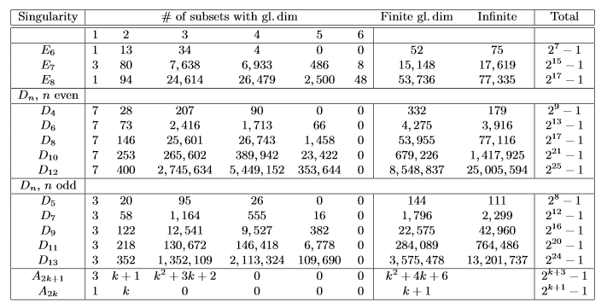
Results
Invariant rings (surface singularities):
Curve singularities:

Slide 50
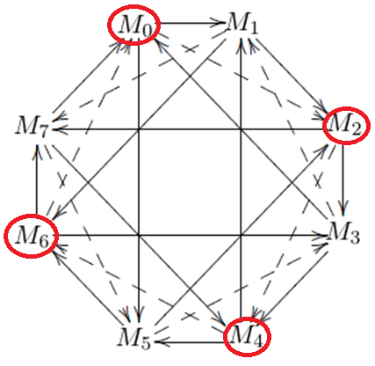
Theorem
If the AR quiver of a ring R has a tau-orbit J of order a, and no module in J has a predecessor in J, then there are modules over R whose endomorphism rings have each global dimension from 2 up to a + 1.

Slide 51
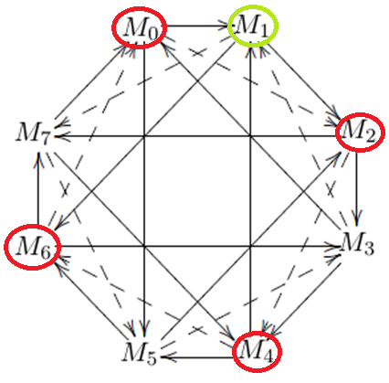
Proof

Slide 52
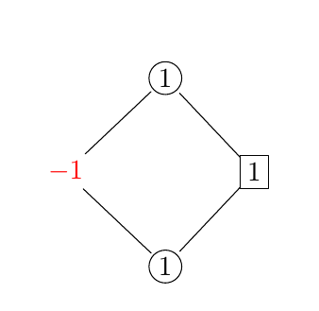
Proof
Sequence for N

Slide 53
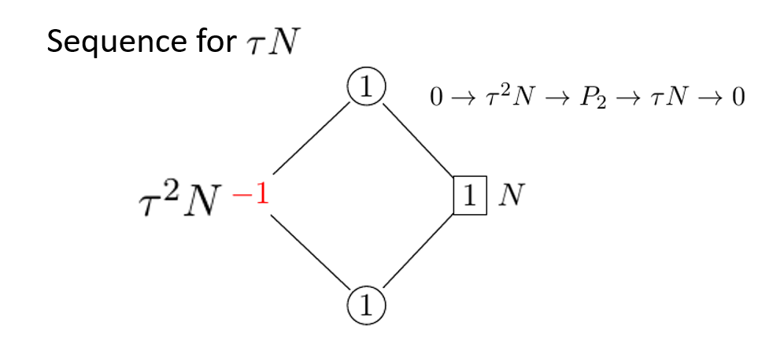
Proof

Slide 54
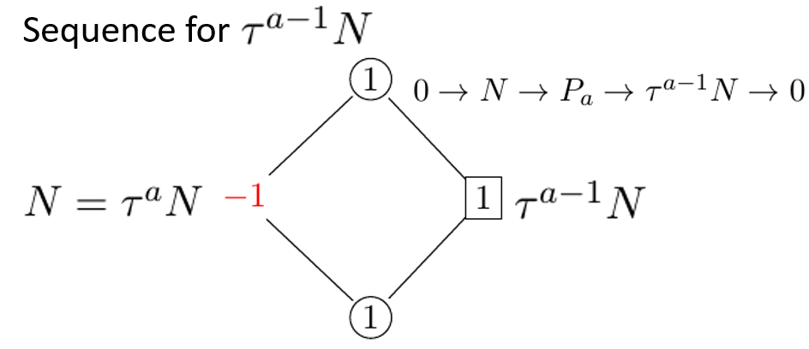
Proof

Slide 55
Proof
Approximating
Say is some indec. summand of the kernel.
If , or , then is a summand of - no need to approximate it further.
If , then its pre-resolution is:
With length a – b + 1.

Slide 56
Proof

Slide 57
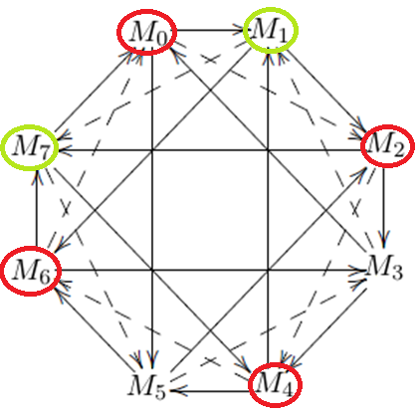
Proof
For other global dimensions: choose all modules outside of J, and modules . Then

Slide 58
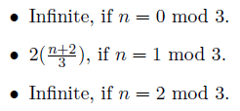
1-predecessor case
Suppose each module in J has exactly one predecessor in J (no multiple arrows), and let
Then the global dimension of is:

Slide 59
Proof
Suppose is the predecessor of N in J. Because is an automorphism, is the predecessor in J of for all .
There must be an arrow . Must also be an arrow . Thus 2k = 1 mod a.
So a is odd, and .

Slide 60
Proof
Approximate a module in J , not the successor of N:
Approximate the successor of N, :

Slide 61
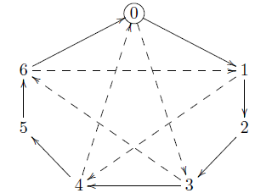
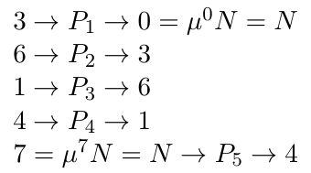
Proof
Let Reorganize J into a μ-orbit. The kernel of the approximation of a module in J is given by jumping forward three positions in the μ-orbit, unless we would pass over N, in which case we land immediately on

Slide 62
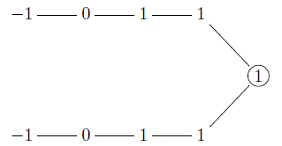
Proof
Sequence for a module outside of J: the kernel is the sum of kernels of approximations of its predecessors in J, plus some modules outside of J.

Slide 63
Proof
Say Then hhhhhhhhhh for any c. So because at least one module in J must have a successor outside J (J cannot be the entire quiver, and must be connected to the rest of the quiver), then they all do. Thus all modules in J must be approximated in order to approximate their successors outside J.

Slide 64
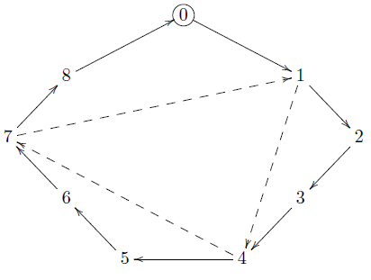
Case 1: a = 0 mod 3
We must find sequences for (the successors outside J of) all modules in J, including .
1 = a – 2 mod 3, so we eventually arrive at a – 2, then return to 1. So the pre-resolution never terminates.

Slide 65
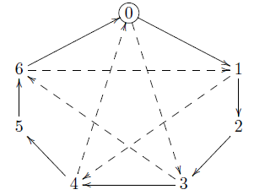
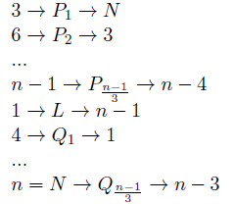
Case 2: a = 1 mod 3
First consider the sequence for N. Because a – 1 is divisible by three, we eventually get a – 1 as a kernel. The next kernel will be 1; continuing to add multiples of 3, we eventually arrive at a, since a = 1 mod 3.

Slide 66
Case 2: a = 1 mod 3
So the pre-resolution is:
with length .
In approximating any other module, we always get length less than or equal to .

Slide 67
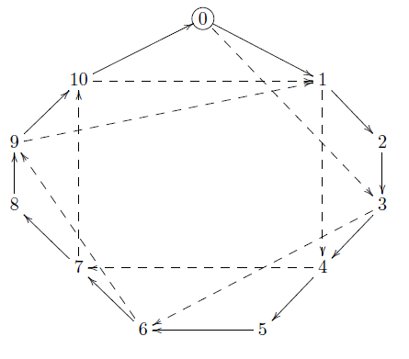
Case 3: a = 2 mod 3
Consider the sequence for N. Now a – 2 is divisible by three, so we eventually get a – 2 as a kernel. The next kernel will be 1. Continuing through the μ-orbit, we get a – 1, then jump back to 1. So the approximation never terminates.

Slide 68
References
O. Iyama and M. Wemyss. The classification of special Cohen-Macaulay modules. Math. Z., 2010. http://arxiv.org/abs/0809.1958
V. Dlab and C. M. Ringel. The global dimension of the endomorphism ring of a generator-cogenerator for a hereditary artin algebra. C. R. Math. Acad. Soc. Sci. Can. https://www.math.uni-bielefeld.de/~ringel/opus/dr.pdf
Y. Yoshino. Cohen-Macaulay Modules over Cohen-Macaulay Rings. Cambridge University Press, 1990.

